Slide 1
Scrum Master Qualified

Slide 2
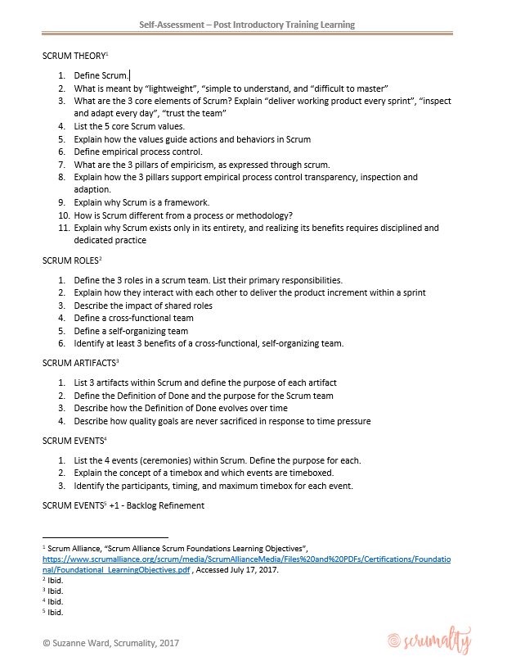
Get Started …
Read – Train – Assess

Slide 3
Week 0

Slide 4
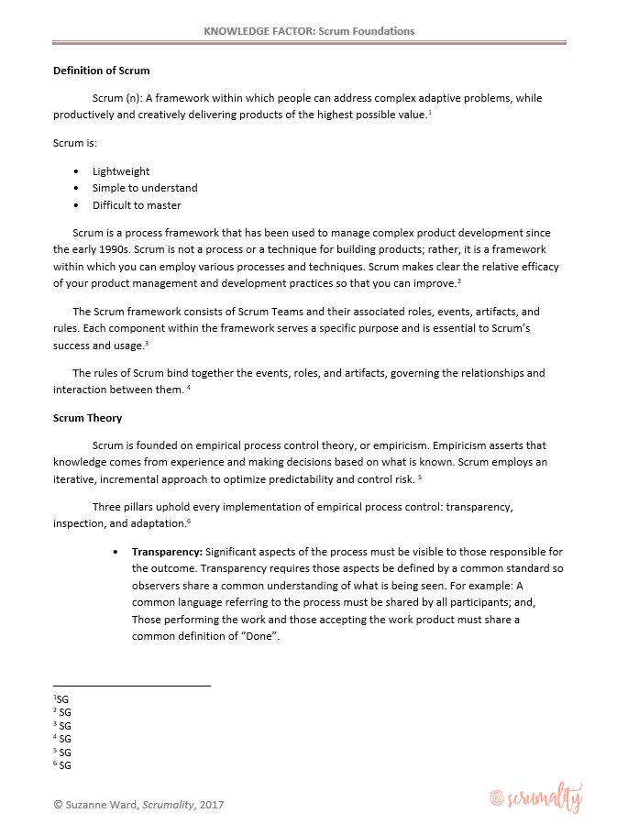
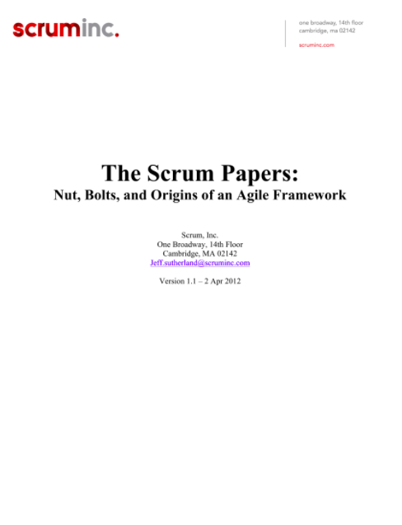
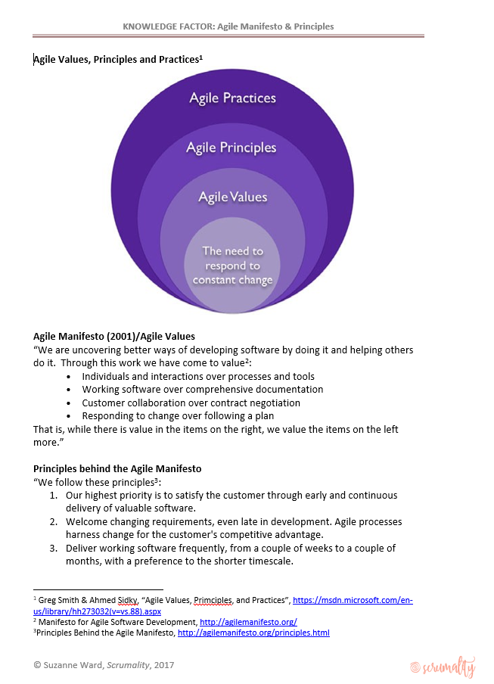
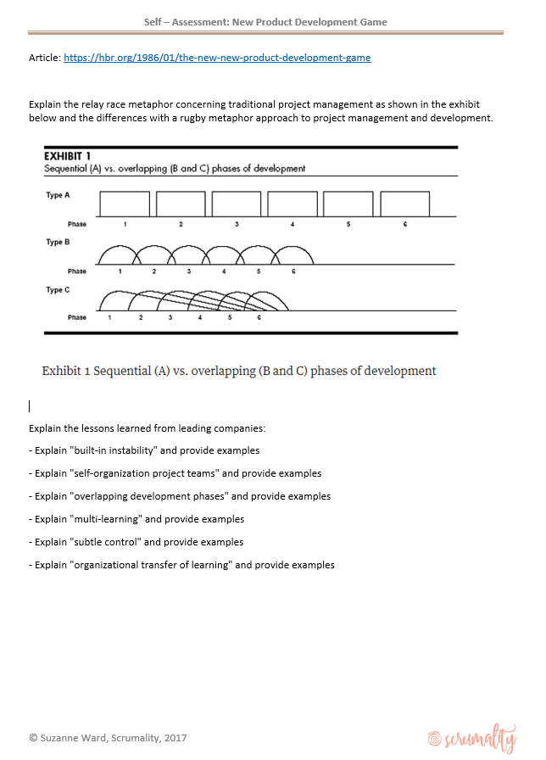
Week 0 - Readings

Slide 5
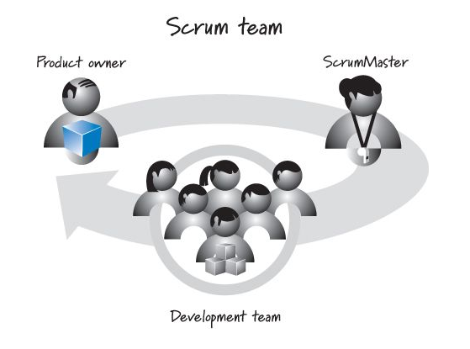
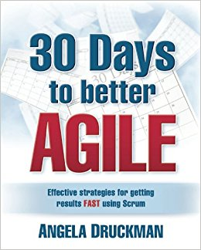
Week 0 -- Activities
Get access to book: 30 Days to Better Agile by Angela Druckman.
You will need this to get started on your next few weeks of learnings. You will read along with related knowledge factors.
Find a team or teams you can observe through the program, especially product owners and scrum masters.
Find a local scrum coach or mentor.

Slide 6
Week 0 – Self Assessment
After each Knowledge Factor, test your comprehension with the self-assessment criteria at the end of each
Got questions or concerns …. Scrumality@gmail.com

Slide 7
VAL Attribution – for most scrum process graphics

