Slide 1

Scrum Master Qualified

Slide 2

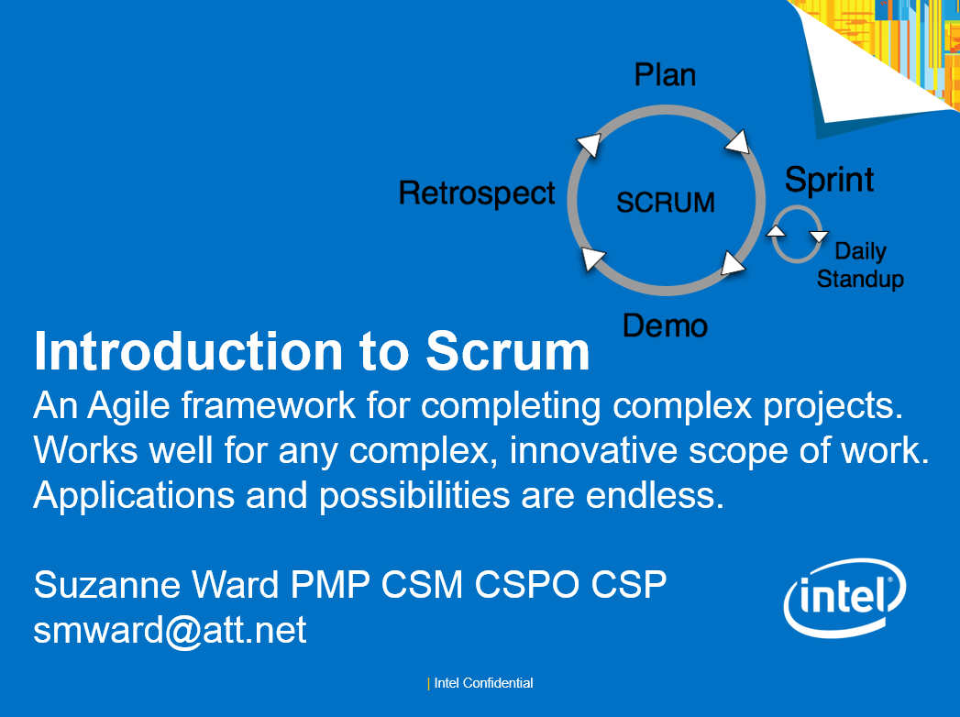
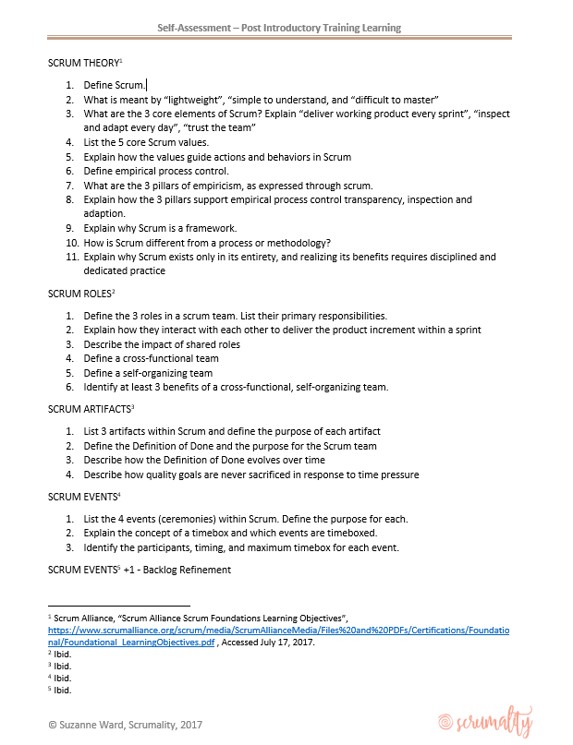
Get Started …
Read – Train – Assess

Slide 3
Week 0

Slide 4
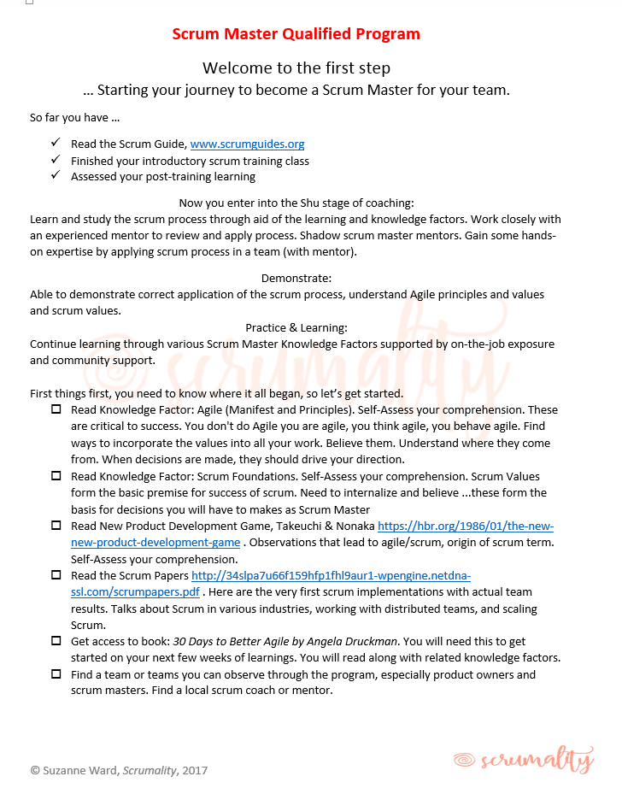
Week 0

Slide 5
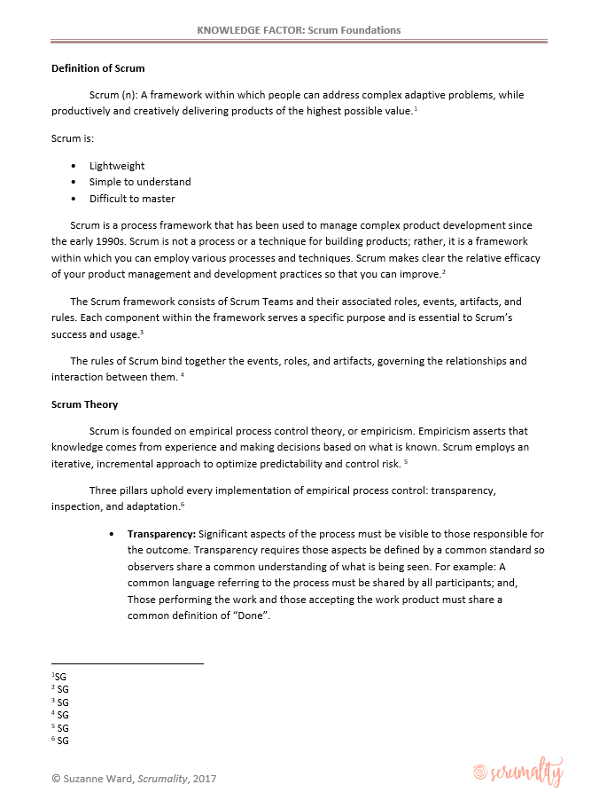


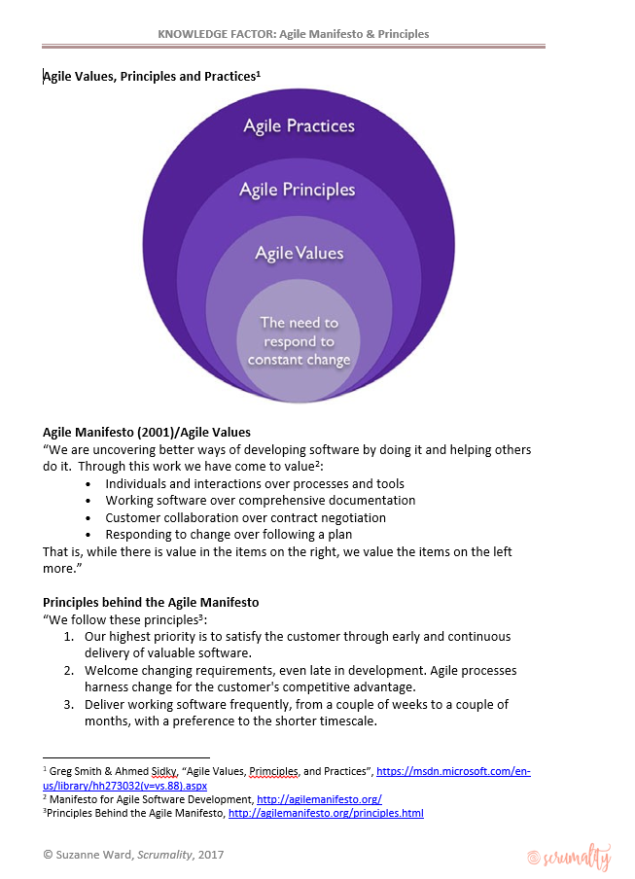
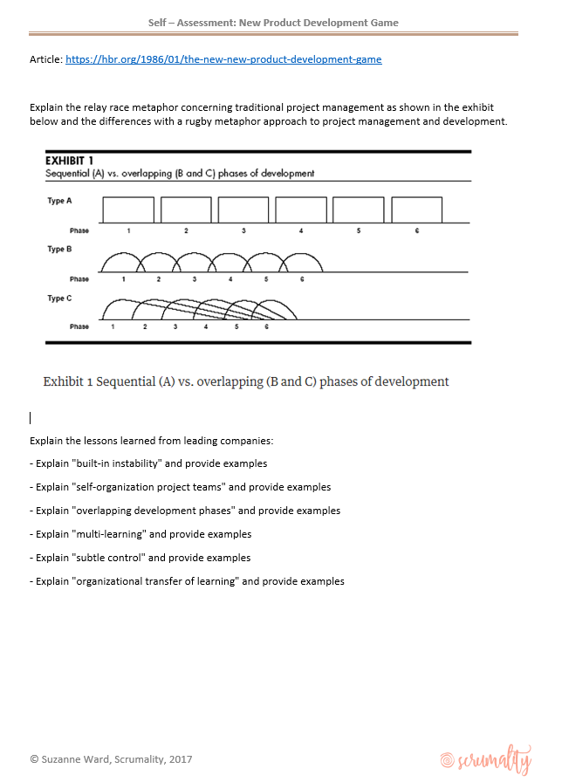
Week 0 - Readings

Slide 6
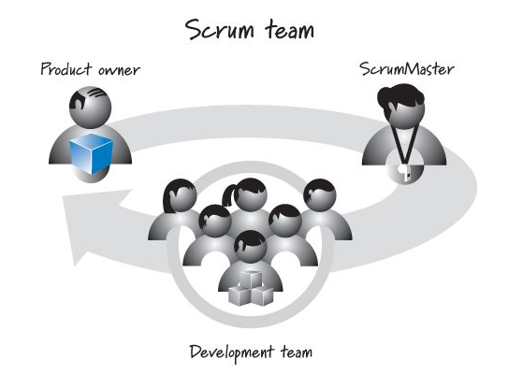
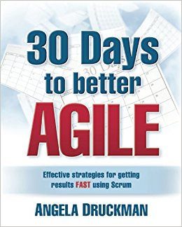
Week 0 -- Activities
Get access to book: 30 Days to Better Agile by Angela Druckman.
  You will need this to get started on your next few weeks of learnings. You will read along with related knowledge factors.
Find a team or teams you can observe through the program, especially product owners and scrum masters.
Find a local scrum coach or mentor.

Slide 7
Week 0 – Self Assessment
After each Knowledge Factor, test your comprehension with the self-assessment criteria at the end of each
Got questions or concerns …. Scrumality@gmail.com

Slide 8
Week 1

Slide 9
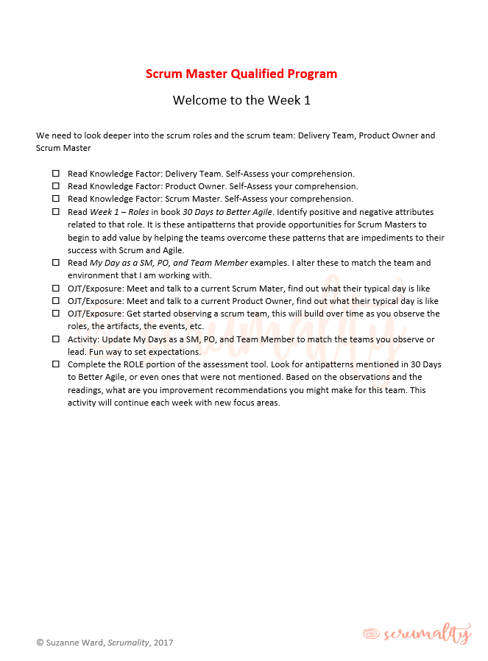
Week 1

Slide 10
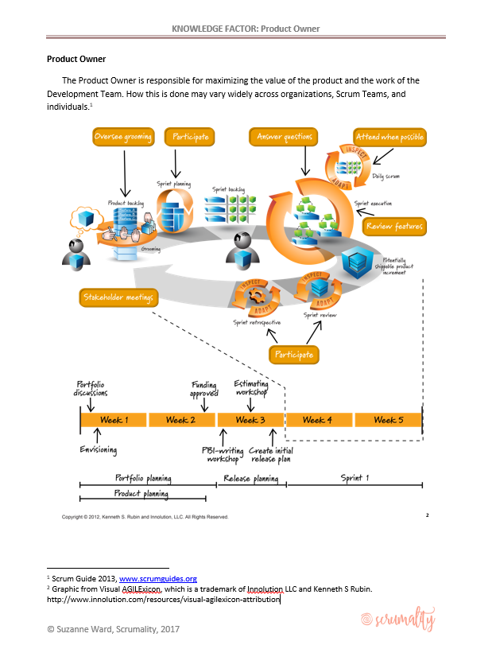
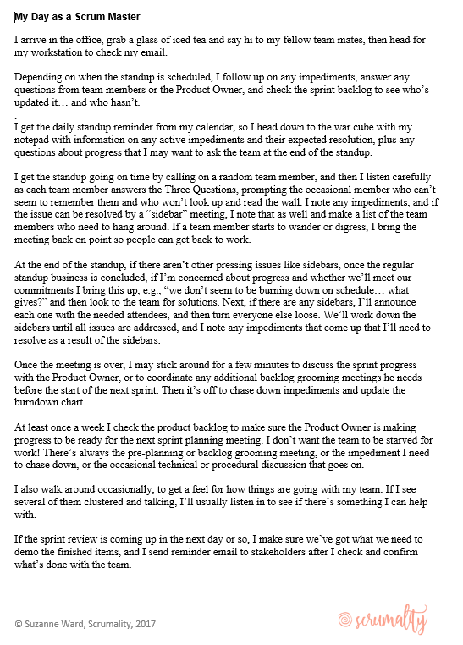
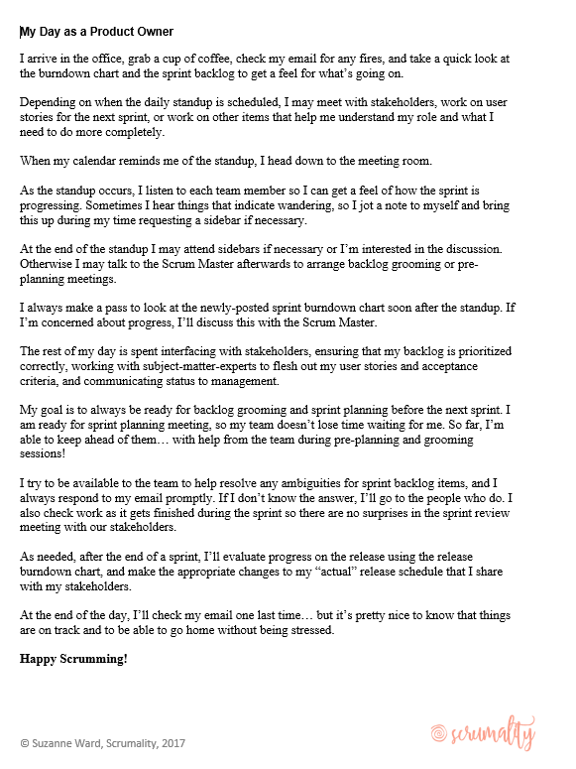
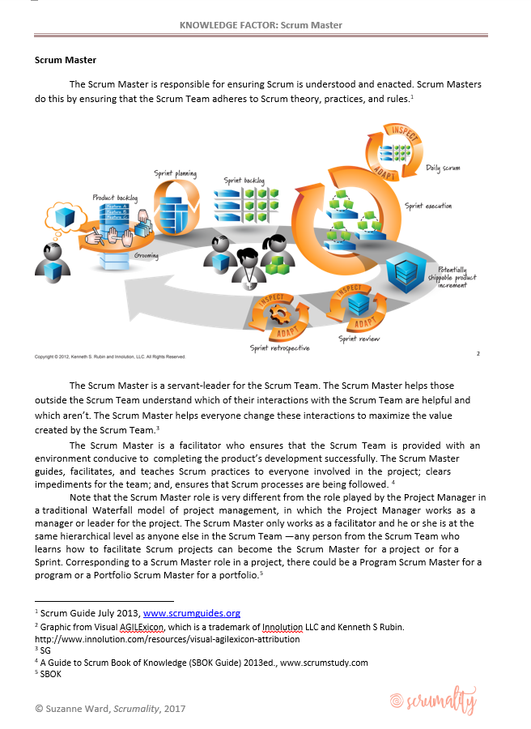
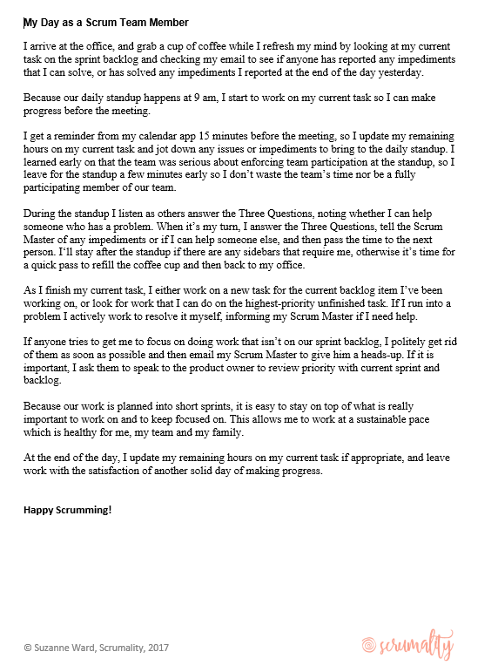
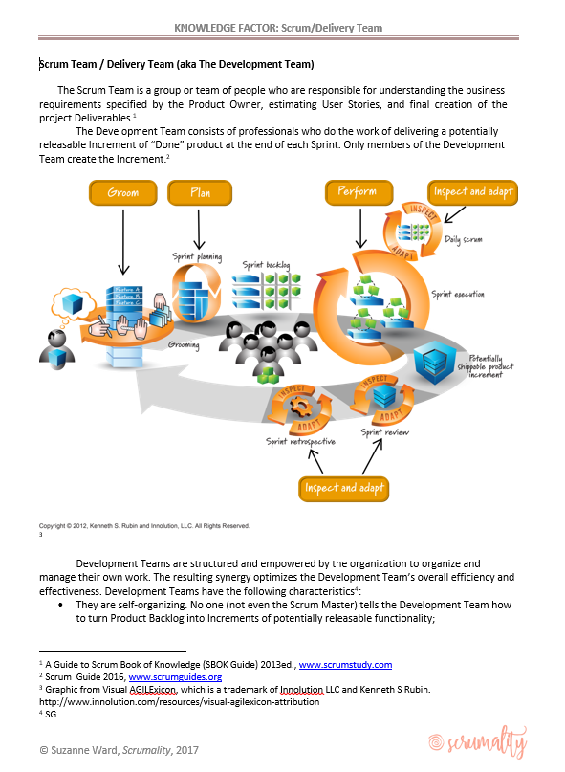
Week 1 – Readings
Week 1 - Roles

Slide 11
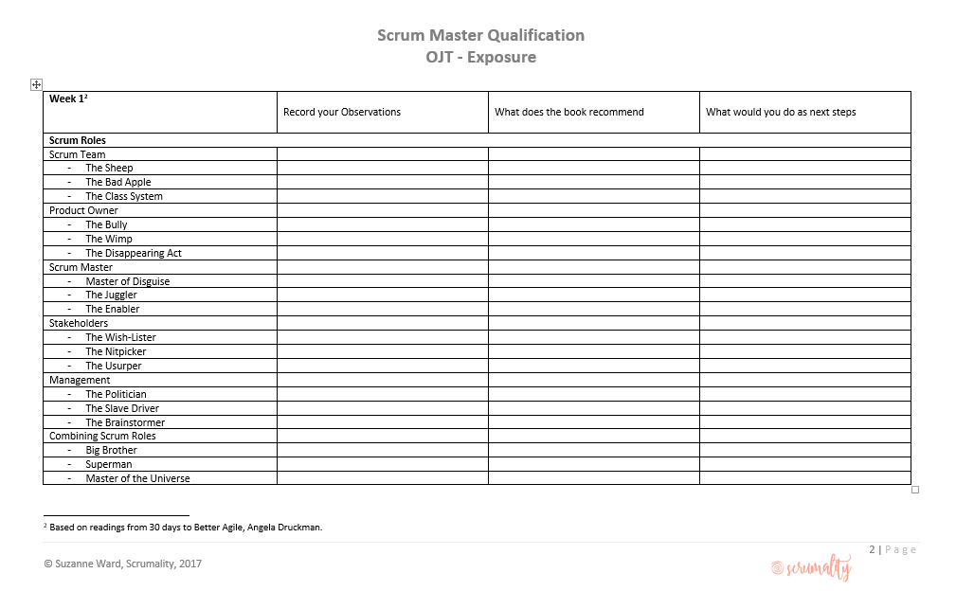
Week 1 -- Activities
Interview a Scrum Master, Product Owner
Observe as Scrum Team
Update My Day as …. For you team or observed team
Complete the ROLE portion of the assessment tool after observing scrum team

Slide 12
Week 1 – Self Assessment
After each Knowledge Factor, test your comprehension with the self-assessment criteria at the end of each
Got questions or concerns …. Scrumality@gmail.com

Slide 13
Week 2

Slide 15

VAL Attribution
– for most scrum process graphics

